Slide 1
Bare Metal C Shell
Kyle Spencer

Slide 2
What is it?
A bare metal program ( no OS ) for x86 systems
Runs either directly on hardware or in VM ( qemu )
Written in C with some assembly
Interacts with hardware directly ( standard IO instructions, memory mapped IO )
Ultimately implements a simple shell

Slide 3
Demo

Slide 4
Components
Interface for installing interrupt handlers
Drivers for the terminal and keyboard
String manipulation functions
PCI driver

Slide 5
Program lifecycle
Bootloader calls first assembly function
Setup stack from assembly
Call main C function
Setup terminal
Setup IDT and GDT
Install keyboard driver
Register shell commands
Loop forever and wait for interrupts

Slide 6
Debugging Process
No standard debuggers ( because it runs alone in VM )
Trial and error to get terminal working
Then print debug data on terminal
Used bochs VM to get memory dumps to analyze ( useful for IDT debugging)

Slide 7
What happens when I type a command?
Keyboard driver handles interrupts, extracts characters, passes them to shell
Shell looks up command handler, calls it
Custom command code executes
Terminal driver is called to show output
Output is converted to string if applicable
String is encoded for display adapter
Encoded screen data is places in the memory region mapped to the display

Slide 8
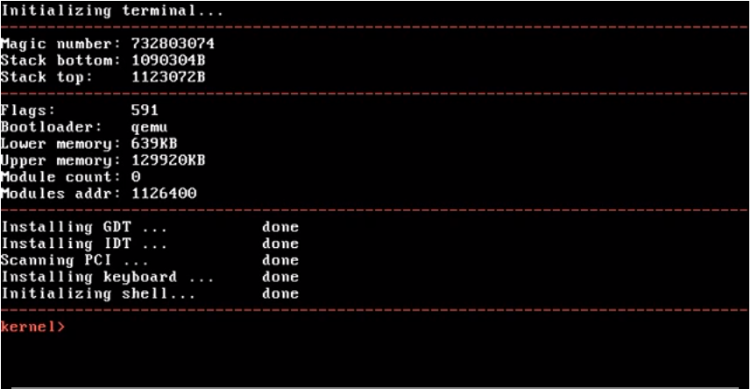
Image: Right after startup

Slide 9
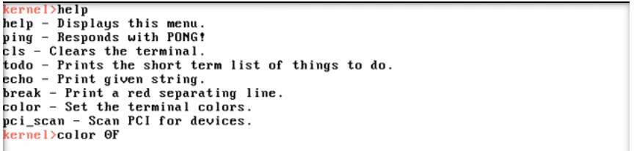
Image: More color support

Slide 10
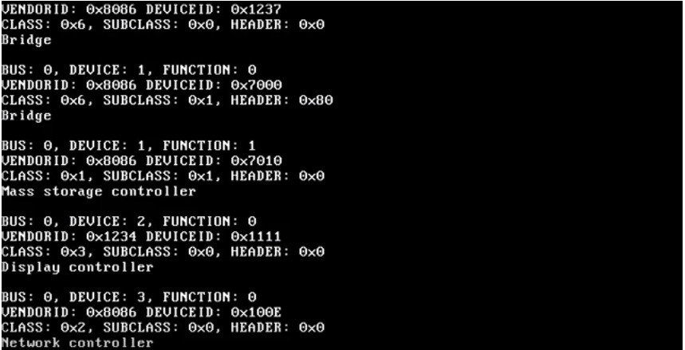
Image: PCI Data

Slide 11
The End
GitHub link: https://github.com/kylecs/Kernel

